Slide 1



Notes:
Headlines got you second guessing your air-travel plans?

Slide 2





Notes:
Sunset Air would like to give you the real story, from the experts, not some news editor. So, before you ditch that dream vacation or swap those boarding…

Slide 3



Notes:
or swap those boarding passes for a long drive, consider this

Slide 4
Notes:
consider this.

Slide 5





23,800K
6%
25%
Source: National Security Council
Notes:
What if I told you that nearly 24 thousand passengers died on the road in 2020? What if I told you that road fatalities have increased recently by 6 percent? What if I said it wasn’t just a small recently, but a 25% rise over the past 10 years? It all sounds headline-worthy, but you won’t find those facts on the evening news.

Slide 6




5
23,800K
11
2
400%
Source: National Security Council
Notes:
If you’ve heard air travel fatalities rose by 400% from 2018 to 2020, you’d be right to be alarmed but this figure would be misleading. The truth is that commercial airlines fatalities have* risen. But that 400% represents an increase from 1 to 5. Not 5 thousand…five. Sure, you could choose to travel instead by bus, or train. But fact is when you want to go far, nothing can get you there faster, safer, than commercial air.
That’s because with every decade that passes, technology and expertise drive accidents lower and lower - despite more planes being in the air than ever before. The most recent data shows that in 2020, over 67 MILLION US passengers took the skies and commercial airlines got nearly every single one of them to their destination. This means, when it comes to air-travel, NOW is always the best time to fly. So what’s the real story? Commercial airlines represent only one type of flight industry. And right now, Non-commercial flight accidents are higher than ever.
Non-commercial airlines include charter flights, private jets, and commuter carriers. There are 10 times fewer of these flights in the air everyday compared to commercial flights, but they now account for nearly half of all accidents and THAT should be concerning for consumers. Our experts agree the reason isn’t a mystery. The fact is these private flights have jumped dramatically in popularity and they simply aren’t held to same high standards and regulations as commercial flights. So, if you want that vacation and you want to survive the great air-scare, that’s easy. Fly commercial, and fly with us at Sunset Air.

Slide 7
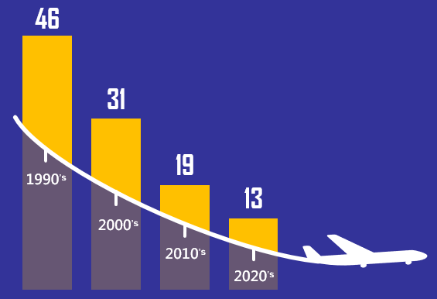
Over 67 Million Passengers
Sources: Aviation Safety Network
Notes:
That’s because with every decade that passes fatalities fall as technology and expertise drive safety higher - despite more planes being in the air than ever before. The most recent data shows that in 2020, over 67 MILLION US passengers took the skies and commercial airlines got nearly every single one of them to their destination safely.

Slide 8

“Now” is Always the safest time to fly!
Notes:
All this means is when it comes to air-travel is NOW is always the safest time to fly. So what’s the real story?

Slide 9

10 X Fewer
Private Jets
Commuter Carriers
Charter Flights
“Now” is Always the safest time to fly!
45%
of Accidents
* Excluding Military
Source: National Security Council
Notes:
While commercial air might represent one of the larger industries in the sky, it’s not the only one. And right now, Non-commercial flight accidents are higher than ever.
What is non-commercial air? Think – private jets. There are 10 times fewer of these flights in the air everyday compared to commercial flights, but they now account for nearly half of all accidents and THAT should be concerning for consumers.

Slide 10





Private Jets
Commuter Carriers
Charter Flights
45%
of Accidents
* Excluding Military
Notes:
Our experts agree the reason isn’t a mystery. The fact is these private flights have jumped dramatically in popularity and they simply aren’t held to same high standards and regulations as commercial flights.

Slide 11

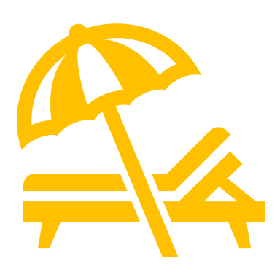

Notes:
So, if you still want that vacation and you want to survive the great air-scare, that’s easy. Fly commercial, and fly with us at Sunset Air.

Slide 12
